Slide 1
Invasive Species & Biosecurity: Potential Pathways for Introduction
Amanda Hodges, Ph.D.
Entomology/Nematology Dept.
University of Florida
Exotic Species & Biosecurity Issues ALS 4161/6166

Slide 2
Objectives
Examine Case Study Examples
Consider Invasive Species Pathways-Accidental v/s Purposeful Introduction
Biosecurity Threat Potential?

Slide 3
Case Study Examples
Barberry (Berberis)
Salmonella outbreaks
Zebra mussels
Citrus greening in Florida
Cherry vinegar fly in Florida
Curry in California
Foot and Mouth Disease

Slide 4
Barberry Eradication, 1918-1930
More information available at: http://www.ars.usda.gov/Main/docs.htm?docid=10755

Slide 5
Salmonella typhimurium
1984, 751 cases in the U.S.
November 2008-March 2009, 691 cases, 9 deaths U.S. states and Canada, peanuts
More Information Available at: http://www.cdc.gov/salmonella/typhimurium/
Notes:
In 1984, a religious cult in the U.S. infected salad bars in the U.S. 751 people became ill. Salmonella is a type of Enterobacteriaceae, and approximately 2000 serotypes of this genis are known to cause disease in human beings. Photo Credit: Janice Haney Carr/CDC

Slide 6
Salmonella Saintpaul Outbreaks
2008
Jalapeno and Serrano Peppers from Mexico
2010, Florida Senate passes food safety legislation for Florida tomatoes
Notes:
Approximately 1400+ cases
Florida has 32,400 acres of planted tomatoes. Each tomato business would be required to pay a flat inspection fee of $100 annually for administrative costs.

Slide 7
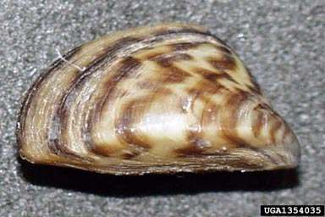
Zebra Mussels, Dreissena polymorpha
1988, Lake St. Clair
Within 10 years, all 5 Great Lakes, the Mississippi, Tennessee, Hudson, and Ohio River Basins infested
One female: 1 million eggs/year
Photo Credit: U.S. Geological Survey Archive
http://www.invasive.org/ Image No. 1354035
U.S. Department of the Interior, U.S. Geological Survey, Distribution Map
http://nas.er.usgs.gov/taxgroup/mollusks/zebramussel/zebramusseldistribution.aspx
Notes:
A non-native mussel originally detected in Russia. Fecundity and the small, microscopic size of immatures make them successful invaders. Full-size adults are slightly less than 2 inches in length, attach to objects, and remain stationary. These mussels, attach to anything, including each other.

Slide 8
Zebra Mussels, Dreissena polymorpha
U.S. Fish and Wildlife Service estimates that this mussel will cost billions of dollars in the Great Lakes Region for the U.S. and Canada over the next 10 years
Photo Credit: Pipe clogged with zebra mussels.
Craig Czarnecki, Michigan Sea Grant
http://www.invasive.org/ Image No. 5411907
Video: http://www.youtube.com/watch?v=-V5513w1XSk

Slide 9
Citrus Greening(Huanglongbing) Liberibacter asiaticus

Slide 10
Citrus Greening(Huanglongbing) Liberibacter asiaticus
First Detection of Citrus Greening, Liberibacter asiaticus
September 2005
Listed as a Select Agent until October 2008
Photo Credit: FDACS-DPI
http://www.doacs.state.fl.us/press/2005/09022005_2.html
http://www.selectagent.gov/resources/Biennial%20Review_APHIS_20081016.pdf

Slide 11
Citrus Greening(Huanglongbing) Liberibacter asiaticus
The Vector, Asian Citrus Psyllid, Diaphorina citri
Arrived in Florida in 1998
Occurs on other ornamental hosts, including orange jasmine, Murraya paniculata
Photo Credit: FDACS-DPI

Slide 12
Citrus Greening(Huanglongbing) Liberibacter asiaticus
“Citrus greening quarantine zone has been expanded to the entire state of Florida.”
“Nursery - All citrus nursery stock that is produced or located within an established citrus greening quarantine area shall not be eligible for movement or distribution outside of the citrus greening quarantine area, except citrus nursery stock intended for export to foreign markets.”
Source: FDACS-DPI Website, http://www.doacs.state.fl.us/pi/chrp/greening/cgmaps.html
August 28, 2009

Slide 13
Citrus Greening(Huanglongbing) Liberibacter asiaticus
“Homeowners in Residential Areas - While the planting of certified citrus in a citrus greening quarantine area is allowed, the movement of citrus plant material outside of the quarantine area is prohibited.”
Source: FDACS-DPI Website, http://www.doacs.state.fl.us/pi/chrp/greening/cgmaps.html
August 28, 2009

Slide 14
Cherry Vinegar Fly, Drosophila suzukii
Photography credit: University of California Cooperative Extension, Mariposa County

Slide 15
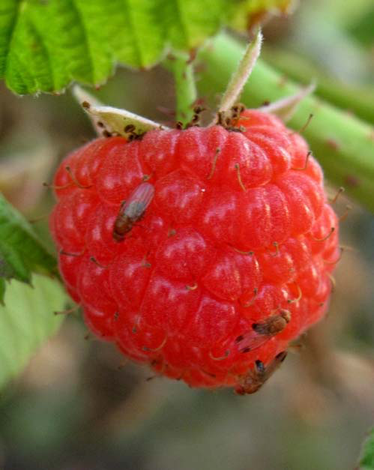
Cherry Vinegar Fly or Spotted-Wing Drosophila
Photography Credit: G. Arakelian, Los Angeles County Agricultural Commissioner/Weights & Measures Department
Image at: http://www.pestalert.org/newsAlertDocs/Drosophila%20suzukii%20Bolda%209July09.pdf

Slide 16
Cherry Vinegar Fly or Spotted-Wing Drosophila
Arrived in California in 2008
Lays in pre-harvest fruit
A potential threat to Florida’s strawberries, blueberries, and other fruit-based commodities.

Slide 17
Cherry Vinegar Fly or Spotted-Wing Drosophila
If you find maggots in fruit arriving from California, report and submit sample.
Do not discard of remaining fruit in your yard.
Double-bag and dispose in your household trash can.

Slide 18
Cherry Vinegar Fly or Spotted-Wing Drosophila

Slide 19
Curry in California?
Photo Credit: Charles Haynes http://www.flickr.com/photos/haynes/2200901457/sizes/l/

Slide 20
Curry in California?
July 2009
Trained Dog Detects curry leaves in FEDEX package shipped from India.
Asian Citrus Psyllids were present.
Later determined to be Citrus Greening (+)
Image Available at: http://www.paajaka.com/2007/04/curry-leaves-kudhi-menusu.html

Slide 21
Dogs in Action!
Sacramento County sniff dog finds 100 Asian Citrus Psyllids this week!
August 27, 2009
http://yubanet.com/california/Sniff-Dog-Finds-Asian-Citrus-Psyllids-at-Sacramento-Package-Facility.php
Beagle Makes News-http://www.youtube.com/watch?v=Tw-XaO0oT9o&feature=related

Slide 22
Regulating Meat and Meat Product Importation
http://www.aphis.usda.gov/import_export/animals/animal_import/
animal_imports_fmd.shtml

Slide 23
Foot and Mouth Disease (FMD)
Two day old ruptured vesicle (blister) on tongue, lower gum and lower lip of a steer
Photo Credit: Australia Department of Agriculture, Fisheries, and Forestry
http://www.daff.gov.au/animal-plant-health/pests-diseases-weeds/animal/fmd/pic-cattle

Slide 24
Foot and Mouth Disease (FMD)
FMD considered the “the most dangerous foreign disease that might be introduced accidentally…or as a terrorist threat”.
Breeze (2004)
Photo Credit: Australia Department of Agriculture, Fisheries, and Forestry
http://www.daff.gov.au/animal-plant-health/pests-diseases-weeds/animal/fmd/pic-cattle

Slide 25
Foot and Mouth Disease (FMD)
7 types of FMD virus and 70 subtypes
Easily spread, including several miles by air
~20 times more infectious than smallpox
Restrictions on carrying meat, cheese, and other meat-related products from infested regions of the world.

Slide 26
References
Breeze, R. 2004. Agroterrorism: Betting Farm More than the Farm.
Exotic Pests and Diseases: Biology and Economics for Biosecurity, Chapters 1-3, 5, 7
Florida Department of Agriculture, Division of Plant Industry (FDACS-DPI) Citrus Health Response Program website http://www.doacs.state.fl.us/pi/chrp/greening/citrusgreening.html
USDA Zebra Mussel Informational Links http://www.invasivespeciesinfo.gov/aquatics/zebramussel.shtml
Lodge, D.M., M.A. Lewis, J.F. Shogren, and R.P. Keller. 2009. Introduction to Biological Invasions: Biological, Economic, and Social Perspectives. In: Bioeconomics of Invasive Species: Integrating Ecology, Economics, Policy, and Management. Keller, R.P., D.M. Lodge, M.A. Lewis, J.F. Sogren. Pp. 1-24. Oxford University Press.

Slide 27
Required Readings
ALS 4161 and 6166
Exotic Pests and Diseases: Biology and Economics for Biosecurity, Chapters 1-3 (pages 1-33), Chapter 5 (pages 55-67)
ALS 6166 Only
Border Enforcement and Firm Response in the Management of Invasive Species
Federal Document on Agroterrorism

Slide 28
Class Discussion Topics
Which of the pests and pathogens discussed would the public perceive as the most devastating? Why?
Which of the pests and pathogens listed has the greatest long-term economic impact potential?
Would you consider all of the pests and pathogens discussed a biosecurity threat? Why?

